Slide 1



Cognitive Technical Assistant
Presented by: Caroline Matthews

Slide 2
Cognitive Technical Assistant – Use Case
“Enabling an intelligent repository of quick searchable knowledge aggregated from engineering information to reduce time spent by Engineers, Operators, and Service Technicians.”

Slide 3
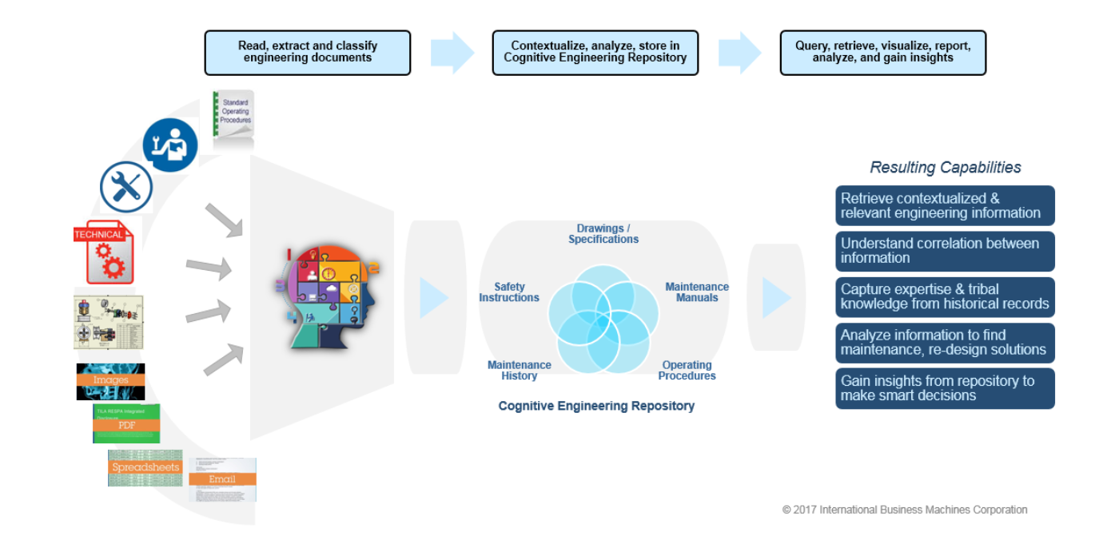
Cognitive Technical Assistant (Cross Industry)

Slide 4
Demonstration

Slide 5
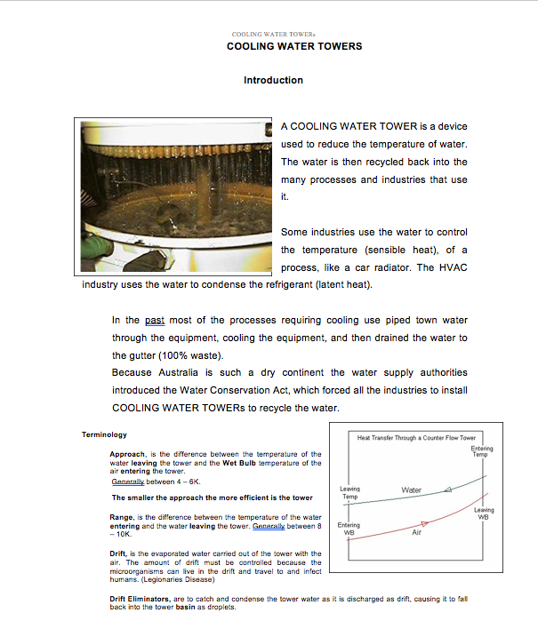

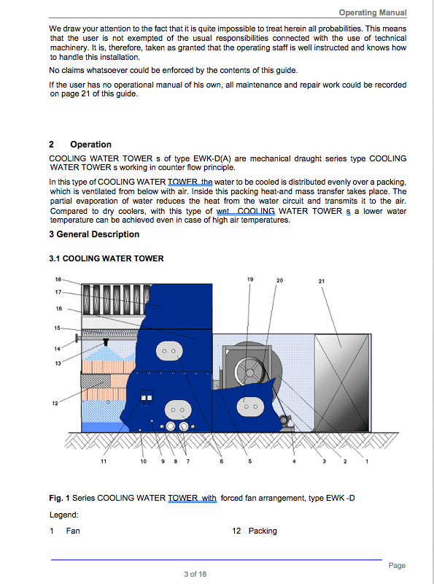
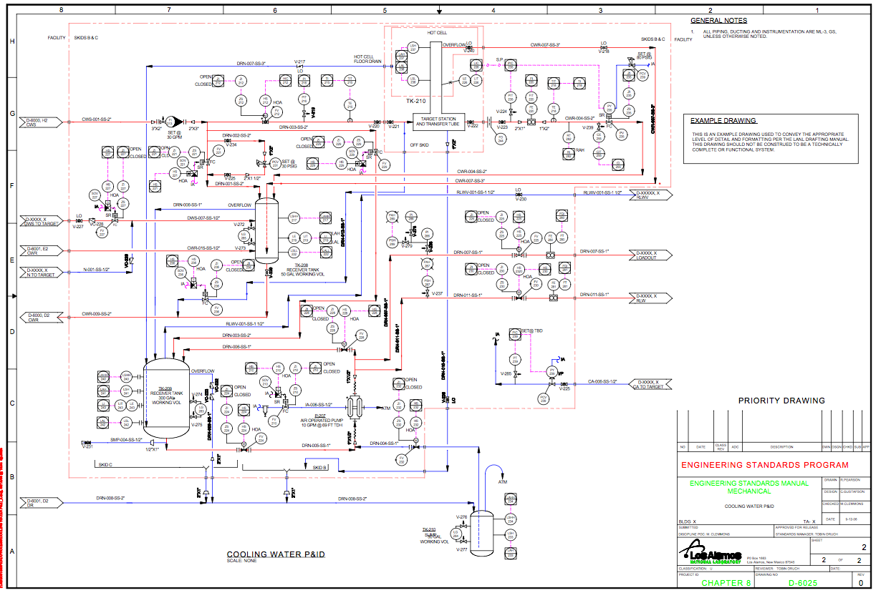
Joe said…

Slide 6
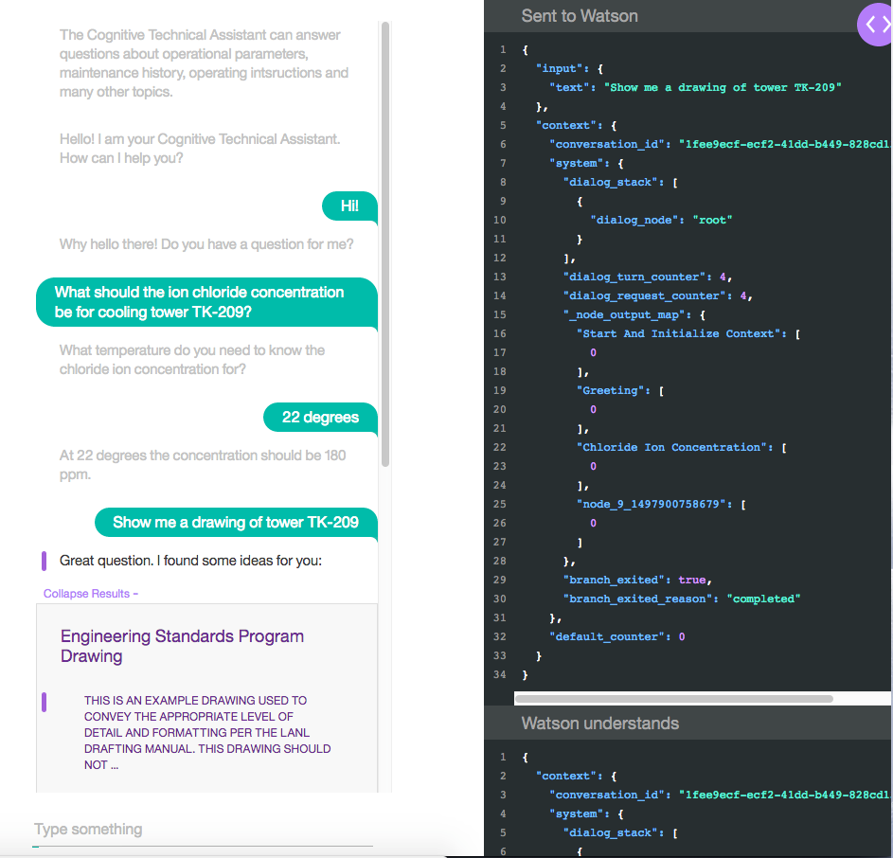

Slide 7
Solution Architecture

Slide 8













COGNITIVE TECHNICAL ASSISTANT ARCHITECTURE
ON-PREMISES NETWORK
CLOUD NETWORK
PUBLIC NETWORK
2
6
KNOWLEDGE
ENGINEER
GROUND
TRUTH
4
CONVERSATION
(TRAINED AND DEPLOYED)
1
SECURED
CONNECTIVITY
3
INGESTION APPLICATION
5
PROJECT HIERARCHY
TECHNICAL
REPOSITORY
EDGE
SERVICES
PUBLIC APIs
4
7
10
ENGINEERING DRAWINGS
DISCOVERY
SERVICE
DATA CRAWLER
KNOWLEDGE
STUDIO
DISCOVERY
SERVICE
ENTERPRISE DATA
POPULATE COGNITIVE REPOSITORY
COGNITIVE TECHNICAL ASSISTANT
10
9
LEGEND
8
Application
Infrastructure services
Data Store
Capabilities
USER
DEVICE
SECURED
CONNECTIVITY
APPLICATION LOGIC
User
SPEECH
TO TEXT

Slide 9
COGNITIVE TECHNICAL ASSISTANT ARCHITECTURE DETAILS
1
Enterprise Data: Plant engineering documents including as-build drawings, operation procedures, technical specifications, maintenance history, bill of materials, incident reports, etc. Documents can be stored in document management systems, MRP/ERP, databases, and file systems. Project hierarchy information used to guide indexing. This repository, along with knowledge from the institutional SMEs, prepares and trains the cognitive technical assistant.
2
Ground truth: These are the set of artifacts used to train the conversation API. Content from conversation end points, example utterances, and representative SMEs crowdsourced inputs are used to model the intents, context attributes entities, and dialog responses to train the conversation service. Ground truth is also typically split into training, test, and evaluation data.
3
External Data: Third party APIs like IBM Weather Data can be integrated to provide additional information.
4
Internal content is ingested from various enterprise content repositories via the Watson Discovery Service Data Crawler, Watson Discovery Service tooling, and custom applications using ingestion APIs and libraries for specialized content like drawings. External content can be ingested through a custom application using ingestion APIs.
5
A collection of content and cognitive information is stored in a repository to support the system.
6
Knowledge engineer uses the ground truth that has been collected in step 2 and the conversation API tooling to populate the intents, entities, dialog flows, and context for training the conversation API.
7
Watson Knowledge Studio: Used to build models that understand the linguistic nuances, meaning, and relationships specific to the industry or to create a model that finds entities in documents based on defined business rules.
8
Users enter a query for information through a mobile device or web application using business concepts of the domain.
9
Speech to text: For requests that are voice based, application logic uses the speech to text service to convert the spoken utterances into text before passing the request to the conversation API.
10
Discovery Application: A custom discovery application orchestrates all of the business flow and internal API calls to the conversation and discovery services, including any speech to text conversion. Application logic passes the request to the conversation service and checks the level of confidence of the response. If the confidence is above a set threshold, the response is returned to the user, along with any related content (also managed by the application). If the confidence levels are low, the application logic checks for possible answers using the discovery service. IBM Watson Discovery Service processes the query and returns the results to the discovery application.

Slide 10
Wrap-Up

Slide 11
Value Proposition
The Cognitive Technical Assistant can optimize operations and improve knowledge management.
Current | With Cognitive Technical Assistant
Workers (engineers, operators, service technicians) spend 30 minutes to read and understand information required to address an incident or operational procedure. Average 5 incidents/procedures a day 150 minutes (2 ½ hours) each day on searching for information | Each worker spends 5 minutes to search and gather relevant information related to an incident or operational procedure. Average 5 incidents/procedures a day 25 minutes per day spent on researching For 500 engineers/operators/service technicians this frees up more than a 1000 extra hours each day.
Results:
1.) Faster response to outages or incidents
2.) Improved quality of response, better contextual information available faster
3.) Continuous improvement as system learns from experiences.
4.) More time available to address other high value work.

Slide 12

Chemicals and Petroleum
Business challenge
Large oil and gas operations involve a constantly unfolding, interlocking chain of technical and engineering decisions, and the stakes of making the right decision can be enormous. Despite the virtues of making informed, data-driven decisions, the practice can be severely hampered when critical knowledge—contained in maintenance records, project documents and test results—is buried in unstructured form.
An energy company uses cognitive computing to bring its technical data discovery capabilities to a new level of depth and efficiency.
Cognitive transformation
This company is using the powers of cognitive computing to dissect, map out and navigate 30 years’ worth of dense and complex engineering knowledge. Content analytics algorithms identify and score logical connections between and across unstructured documents of all kinds, enabling employees of all stripes—not just subject matter experts—to submit plain-English queries that drill down quickly and accurately to the most relevant and valuable insights.
Business benefits
USD 7.5 million
 | reduction
 | in employee expenses due to faster access to and more intuitive analysis of engineering records
75%
 | reduction
 | in the time spent by the geoscience team reading and searching through data sources
Increases
 | overall productivity
 | by empowering a larger range of employees to interrogate the cognitive system
Energy company in Australia
Solution components
IBM® Global Business Services® – Business Consulting Services
IBM Research
IBM Watson™ Engagement Advisor
IBM Watson Lab Services
Using cognitive analysis
of an ocean of data
to make smarter decisions
This oil and gas explorer, developer, producer and supplier produces liquefied natural gas (LNG) in Northwest Australia. Its exploration portfolio includes emerging and frontier provinces in Australia and the Asia-Pacific region, the Atlantic margins, Latin America and Sub-Saharan Africa.
Notes:
Link to Reference Profile: http://w3-01.ibm.com/sales/ssi/cgi-bin/ssialias?infotype=CR&subtype=NA&htmlfid=0CRDD-A44A9K&appname=crmd About the client
Based in Australia, this oil and gas company produces liquefied natural gas in Northwest Australia. The company’s exploration portfolio includes emerging and frontier provinces in Australia and in the Asia-Pacific region, the Atlantic margins, Latin America and Sub-Saharan Africa.
Business challenge
In advance of a planned overseas expansion, the company’s management recognized the need to optimize its decision-making processes, especially in the area of refinery engineering. Such decisions related to whether, how and when the company should conduct capacity upgrades, lay new pipelines and engage in similar infrastructure projects. Though the processes weren’t broken per se, management exhibited a larger than acceptable reliance on the intuition of experienced personnel as opposed to existing institutional knowledge on a subject. The major underlying reason was that finding this information—embedded in 30 years’ worth of documentation—was tedious, time-consuming and often futile. Company executives knew they needed to make data-driven decision making the norm, not the exception. To achieve that, they needed a way to dramatically simplify the means by which technical and engineering staff could locate, analyze and learn from the existing body of subject matter knowledge throughout the company. By discovering information on a particular technical issue, such as how often to maintain certain refinery equipment, the company could avoid guesswork and prevent “reinventing the wheel” in expensive, time-consuming and redundant tests.
Solution
The company engaged IBM Watson™ Services to develop a cognitive decision optimization solution to support project planning, maintenance and other engineering activities related to its refinery operations. The solution’s corpus of knowledge comprises approximately 30 years’ worth of documents from thousands of engineers related to the company’s activities in running refinery facilities, including testing data and results, project management reports and associated correspondence, the vast majority of which is in unstructured form. In the first phase of the corpus development, advanced text analysis and machine learning algorithms scanned all the content to create a web of relationships between data elements, such as the impact of changes in the pressure and temperature steam used in the refining process on the condition of certain categories of equipment. With these connections established, users can submit a query in the form of a conversational, nontechnical question such as “What’s the relationship between the pressure of steam moving through the nozzle of an ejector system and the likelihood of equipment damage?” Based on the outcome of the connection algorithm, the solution may bring back results from previous tests that establish relationships between improper steam pressures and equipment damage. Engineers can then use this insight to refine maintenance procedures while continually training the solution to improve the quality of its answers.
Quantifiable benefits The solution accelerates response by enabling employees to instantly query 30 years’ worth of tribal knowledge in the IBM Watson system, saving USD 7.5 million annually in employee time—this with only one quarter of the workforce currently having access. It also improves the decisions of geoscience team members now that the time they spend reading and searching for data for certain tasks has been reduced by 75 percent—from 80 percent of their time to 20 percent—leaving more time for decision analysis. And the solution enhances collective knowledge transfer from one generation of employees to the next and increases employee expertise by providing unlimited access to the decades of decision logs from thousands of engineers.
What makes the solution cognitive?
Game-changing outcome - The management and maintenance of oil and gas facilities involve an enormous number of decisions, from day-to-day operations to the design and planning of new facilities. Because practically every decision or action has the potential to affect operating efficiency and safety, improving the quality of decision making has a cumulative positive impact on profitability and competitiveness. The company’s solution is game-changing because it drastically lowers the barriers to extracting actionable insights from institutional knowledge and expertise, thereby promoting more data-driven decision making.
Before-after impact - Prior to the project, engineering staff members needed to manually search for relevant technical information to support their planning and decision-making activities. The new solution provides employees with an intuitive, natural-language interface through which they can query the company’s entire 30-year base of engineering documents for relevant insights on highly specific technical issues.
Data sources and characteristics - The data is a mix of mostly unstructured and some structured data contained in reports and other documentation produced by thousands of engineers over several decades. The data is from mostly internal sources, with some external publicly available data. Volume is several terabytes in Microsoft Word, Excel and PowerPoint along with HTML and PDF formats. It is the equivalent of some 600,000 A4 pages, which would stack as high as the Statue of Liberty.

